Slide 1
New Empirical Generalizations on the Determinants of Price Elasticity

Slide 2
Meta Analysis
An analysis that combines the result of multiple research paper. The fundamental idea behind this analysis is that that is a common truth behind all studies, but which has been measured with a certain error within individual research. Our aim is to find the truth behind using some statistics. (Basically, find the weighted average)
Key benefit for this analysis is the aggregate of information leading to a higher statistical power and more robust point estimate. The weakness is that research has to make choices that can severely affect the results.

Slide 3
Aim
Updating and extending empirical generalization on price sensitivity by presenting the results of a meta-analysis on the determinant of price elasticity. Compared with Tellis’s paper of meta-analysis of price elasticities published in 1988 with 367 price elasticities collected from 1961-1985 (“The Price Elasticity of Selective Demand: A Meta-Analysis of Econometric Models of Sales”).

Slide 4
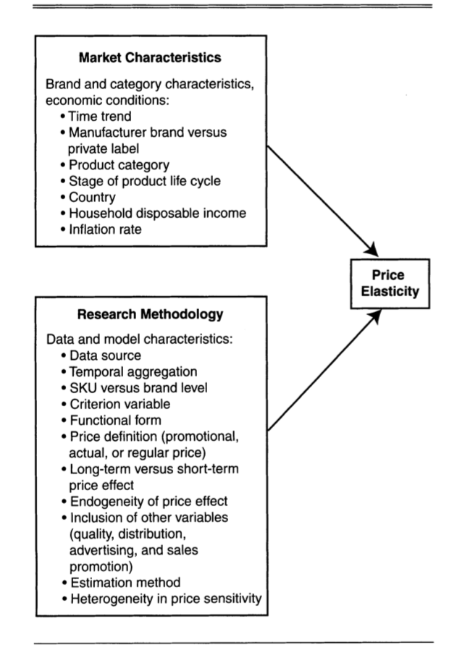
Determinants

Slide 5
Methodology
Gathered all the possible research available
Filtered it along with the following criteria:
Only about brand and SKU elasticities instead of category sales
Elasticity should be about specific single product instead of average across items
Only consider the price elasticities based on actual purchase or sales data
Limit research to B2P markets
Collected household income and inflation rate from credible institutes.

Slide 6
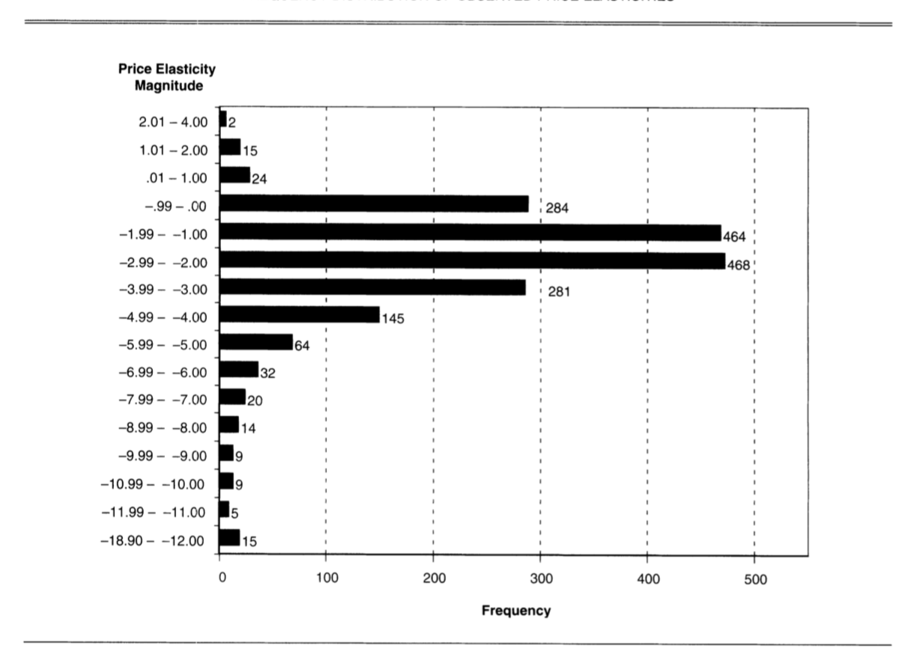
Models price elasticity as a hierarchical linear model of determinants and possible interaction terms.
The model fit is satisfactory and significant.
R^2=0.16
F=9.65 p<0.01

Slide 7
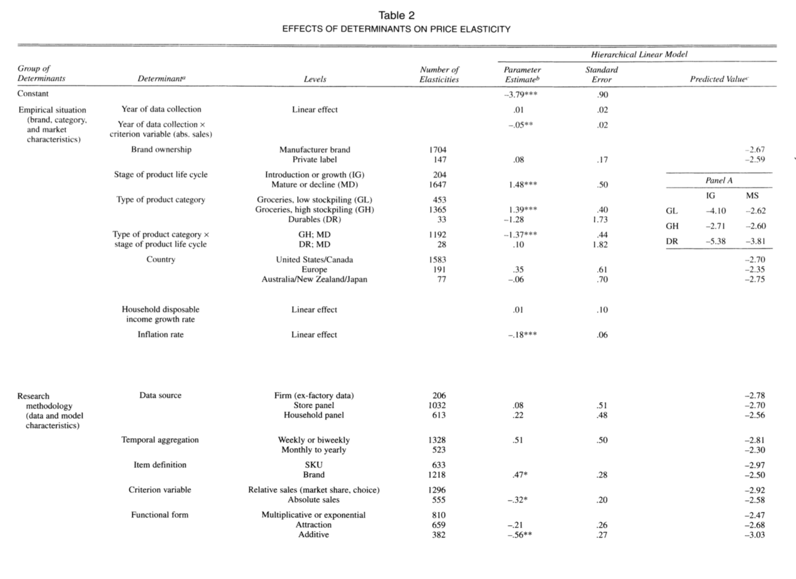

Slide 8
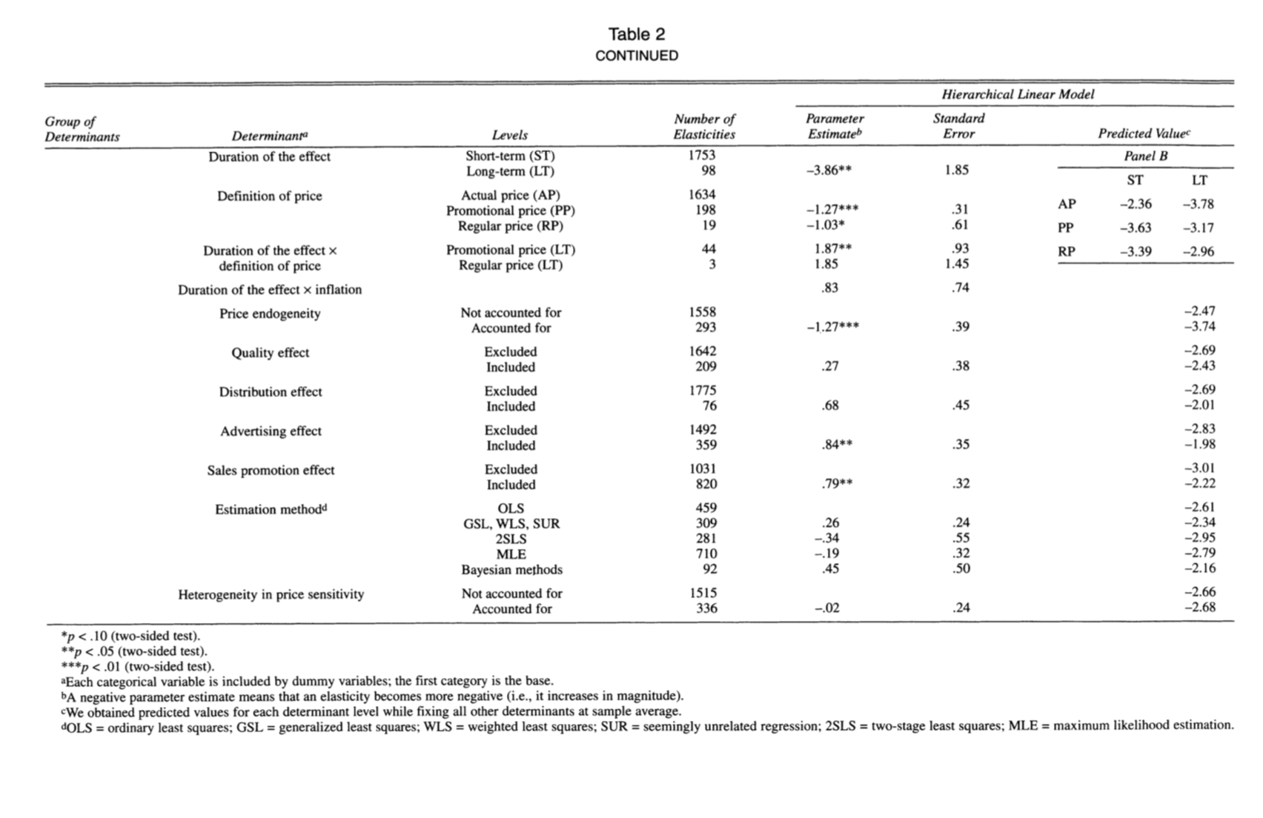

Slide 9
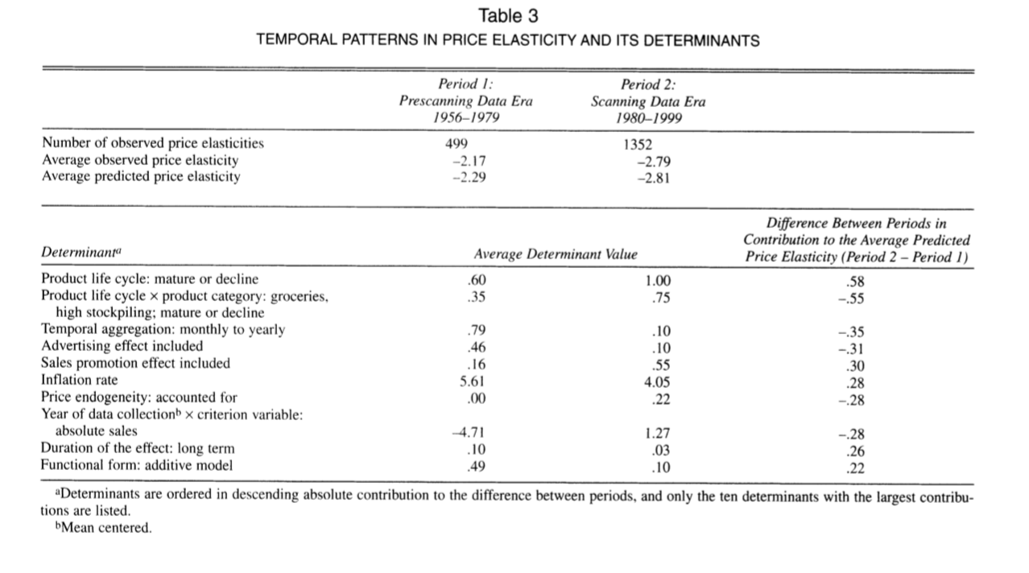

Slide 10
